Slide 1
Piezoelectric Sensors

Slide 2
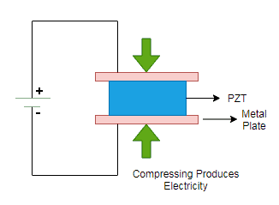
Piezoelectric sensors
Piezoelectric Effect
Piezo is a Greek term signifying “press” or “squeeze”.
Piezoelectricity (also called the piezoelectric effect) is the presence of an electrical potential across the sides of a crystal when mechanical stress is applied by squeezing it.
In working system, the crystal acts like a tiny battery with a positive charge on one face and a negative charge on the opposite face. To make it as a complete circuit, two faces are connected together and current is passed through it.

Slide 3
Applications (Examples)
Mechanical stress analyzer: During construction of building, stress analyzer is used for columns, where the voltage produced due to stress is measured, and corresponding stress is calculated.
Lighters: Gas Burner lighter and cigarette lighter utilizes piezoelectric effect. They produce electric pulse due to force developed by sudden impact of trigger over the material inside.

Slide 4
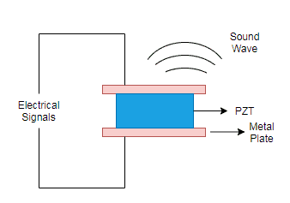
Inverse Piezoelectric Effect
The effect is reversible. Whenever an electric field is applied onto crystal terminals, it undergoes mechanical stress and results in shape change. This is known as Inverse Piezoelectric Effect.

Slide 5
Applications (Examples)
Quartz Watch: In our day-to-day usage, the wrist watch uses quartz resonator that work as an oscillator. The element used is silicon dioxide. When an electric signal is applied across the crystal, the crystal vibrates which helps to regulate the gear inside the watch periodically.
Piezo Buzzers: In many applications like car reverse indicator, computers, etc. buzzers are used. A certain amount of voltage with a value of magnitude and frequency is applied on the crystal, which makes the crystal to vibrate. The vibration is converted into sound

Slide 6
Working of Piezoelectric Sensor
In a piezoelectric crystal the charges are exactly balanced in unsymmetrical arrangement.
The effect of the charges cancel out with each other and hence no net charge will be found on the crystal faces.
When the crystal is squeezed, the charge in the crystal becomes unbalanced.
Hence, from now on the effect of charge does not cancel with each other which make net positive and negative charge to appear on the opposite faces of the crystal.
Therefore, by squeezing the crystal, voltage is produced across the opposite face and this is known as piezoelectricity.

Slide 7
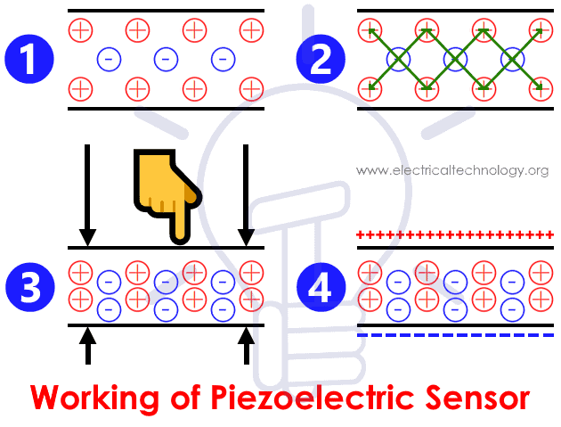

Slide 8
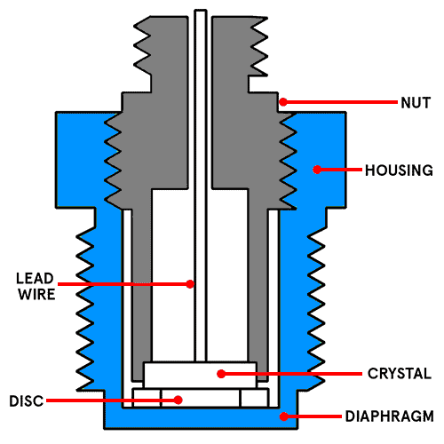
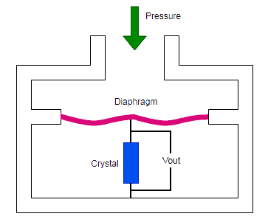
Applications of Piezoelectric Sensors:
1. Piezoresistive Pressure Sensors:
They are used to measure dynamic pressure. Dynamic pressure measurements include turbulence, engine combustion, etc. The pressure changes in liquids and gases in cylinder pressure measurements, hydraulic process can be measured using piezoresistive pressure sensors.
When a force is applied to the piezoelectric diaphragm, it generates electric charge across the crystal faces. The output is measured as voltage which is proportional to the applied pressure.

Slide 9
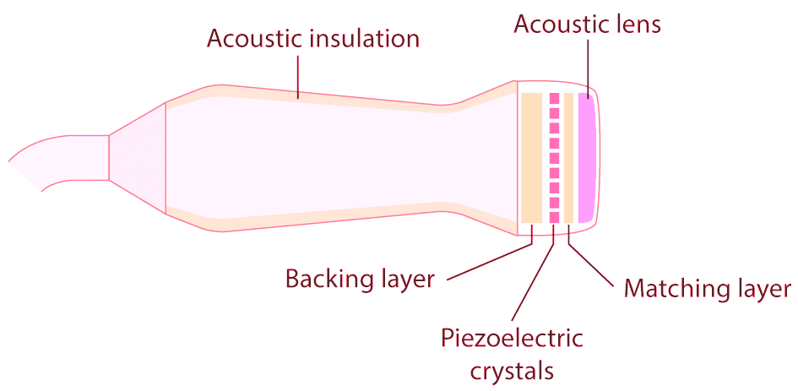
2. Ultrasound Transducer and Piezoelectric Crystals:
Ultrasound sensors generate ultrasonic waves. When transducer is held on one hand, its position is kept varying such that the ultrasound wave passes through the body parts to be analyzed and visualized. Sound waves are sent through the body tissue. The waves are reflected back to create the image of the tissue. This is the working principle of an Ultrasound Imaging System.
In this, piezoelectric crystals are attached to the front of the transducer, which helps to generate ultrasonic waves. Electrodes act as connecting node between crystals and machine. When electric signal is applied to crystal, due to vibration it generates ultrasound wave of frequencies between 1.5 and 8 MHz

Slide 10
In Industrial Applications piezoelectric sensor is used in engine knock sensors, pressure sensors, Sonar Equipment, etc.
Piezoelectric actuators are applied in Diesel fuel injectors, optical adjustment, Ultrasonic cleaning and welding.
Sensor is used in electrical appliances like dot matrix printer, inkjet printer, Piezo speaker, buzzers, humidifiers, etc.
In musical instruments like Instrument pickups and microphone

